Slide 1
MODFLOW 6 Groundwater Flow (GWF) Model

Slide 2
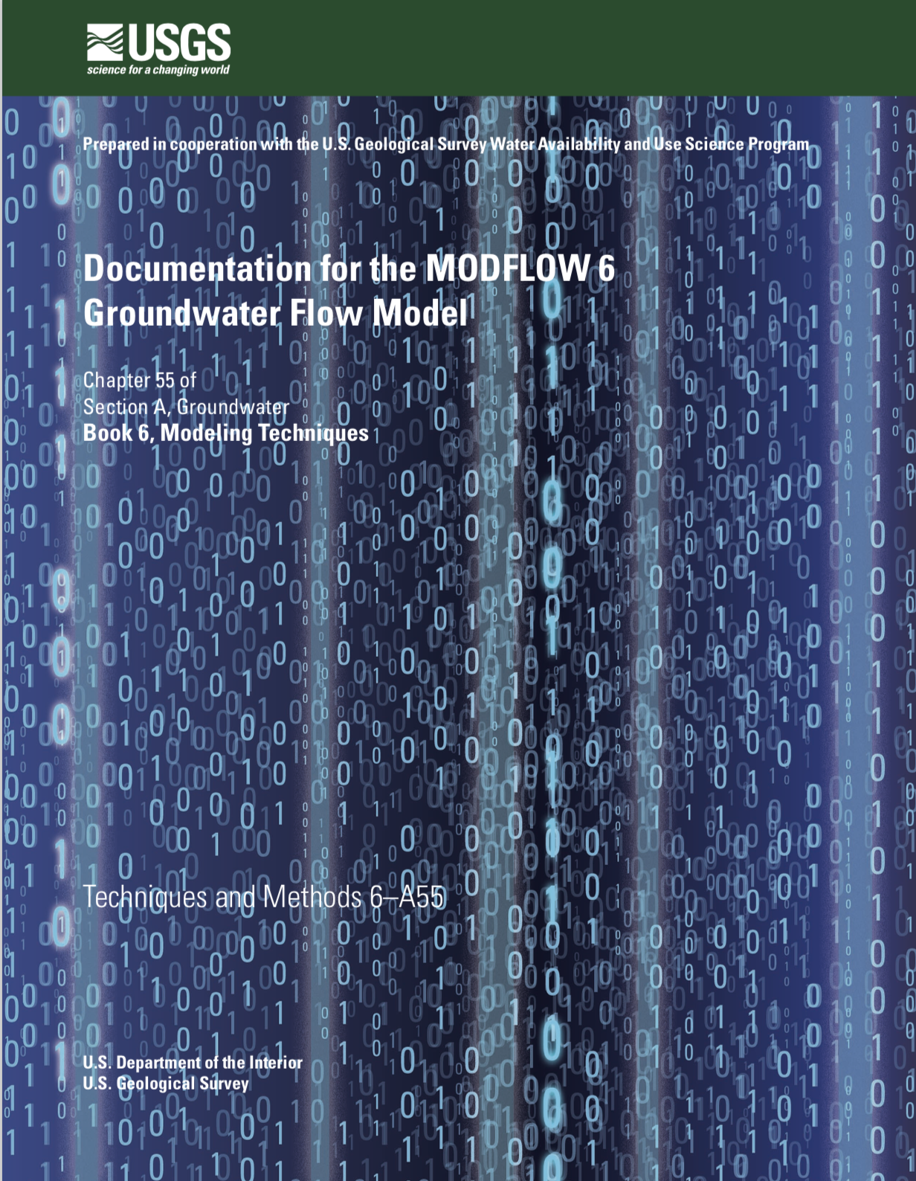
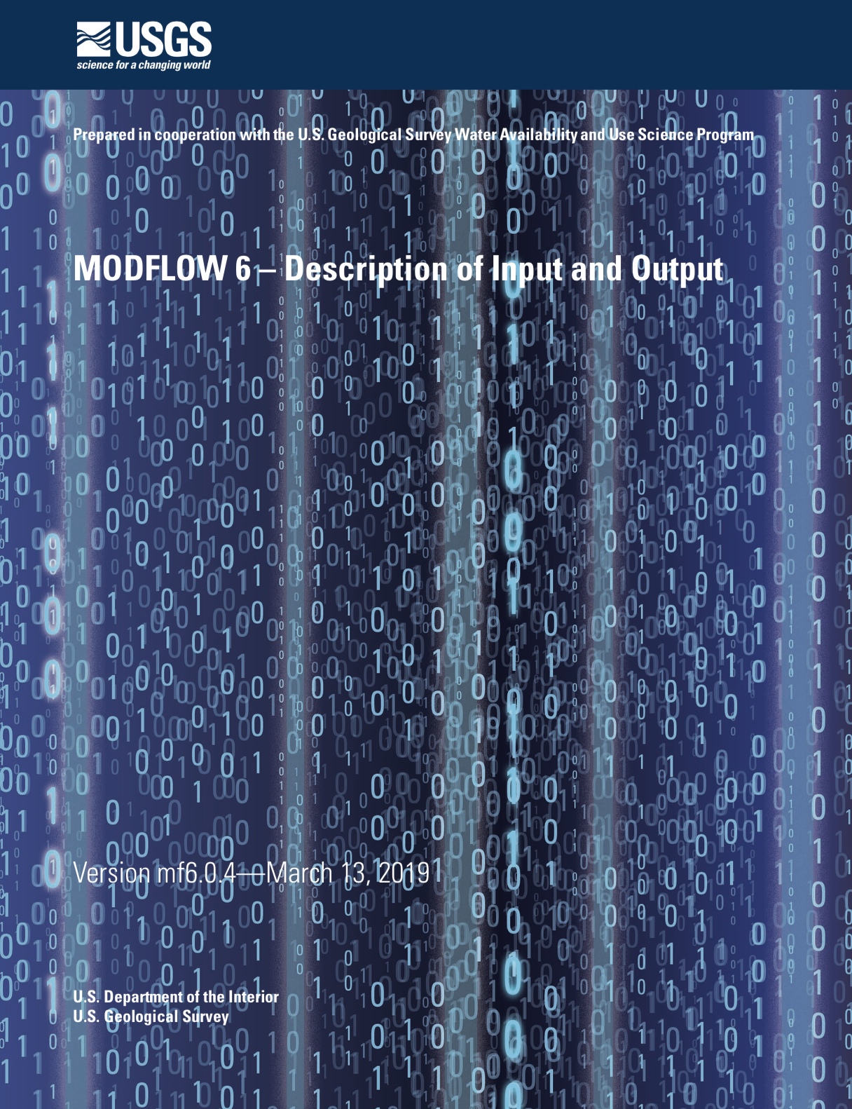
GWF Documentation

Slide 3
GWF Model Highlights
Generalized control-volume finite-difference formulation
Regular MODFLOW grids
Unstructured grids
IDOMAIN capability
Full 3D anisotropy
Multiple stress package ”instances”
Water Mover
Block and keyword input structure

Slide 4
UNDERLYING Formulation

Slide 5
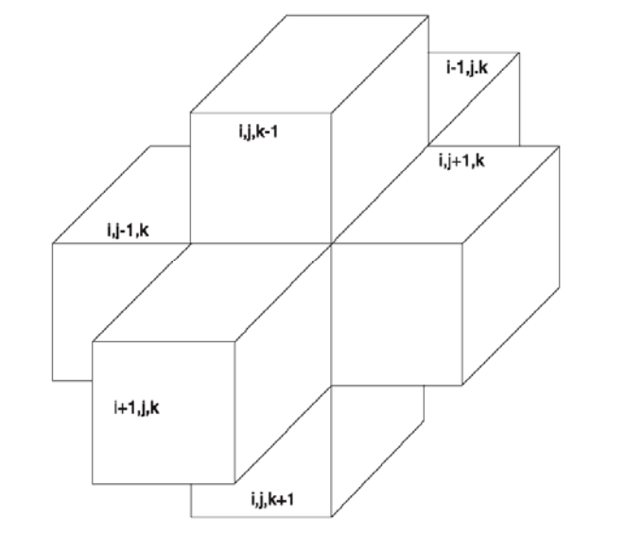
Finite-Difference Equation

Slide 6
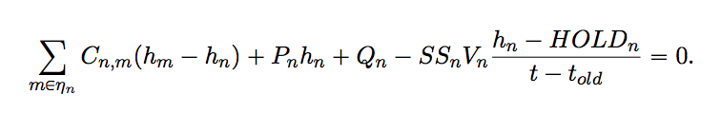
Generalized CVFD Equation

Slide 7
DISCRETIZATION

Slide 8
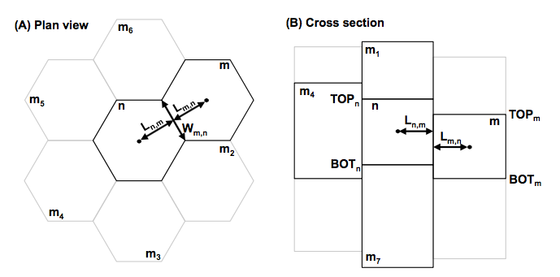
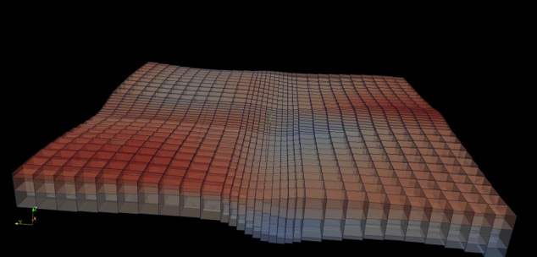
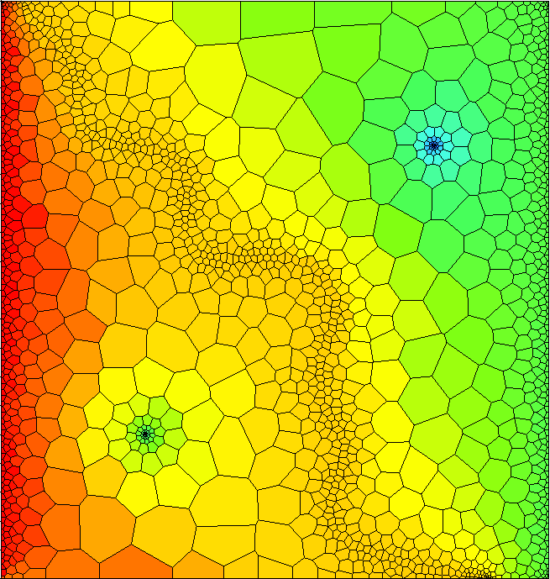
Spatial Discretization
Three ways to enter grid
DIS – regular MODFLOW grid
DISV – discretization by vertices
DISU – fully unstructured

Slide 9
Discretization (DIS) Package
“Regular MODFLOW grid”
Consists of layers, rows, and columns
Top and bottoms can have variable elevations

Slide 10
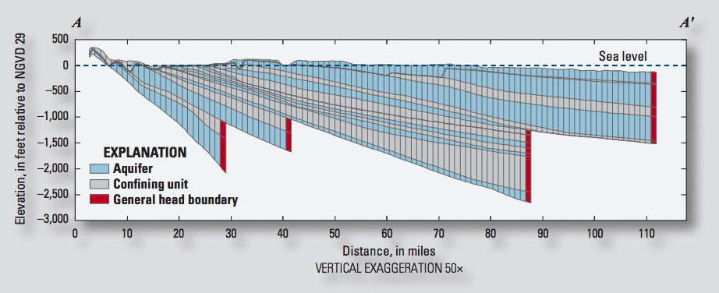
IDOMAIN Capability
Improve efficiency for models with large areas of inactive cells
Address MODFLOW limitations with discontinuous hydrogeologic layers

Slide 11
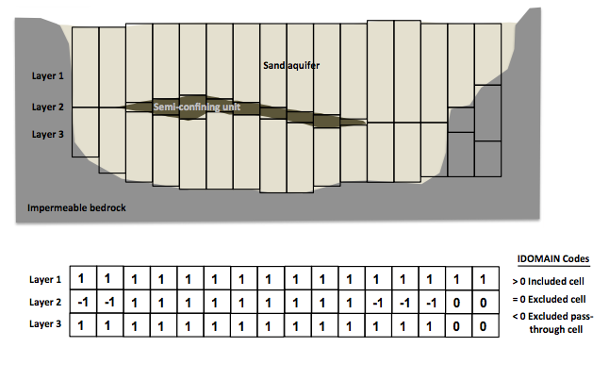
IDOMAIN Capability (cont.)
Permanently remove a cell from the simulation
Can be used with DIS and DISV
Optionally connect overlying and underlying cells

Slide 12
NODE PROPERTY FLOW PACKAGE

Slide 13
Node Property Flow (NPF) Package
Primary purpose is to calculate conductance between adjacent cells
Confined or convertible cells (ICONVERT)
Homogeneous or heterogenous
Isotropic or anisotropic
Handles wetting and drying (REWET, WETDRY) (still available, but the Newton-Raphson method is much better)
Can calculate the three components of specific discharge at the cell center (SAVE_SPECIFIC_DISCHARGE). Nice for vector plots, and required for transport.

Slide 14
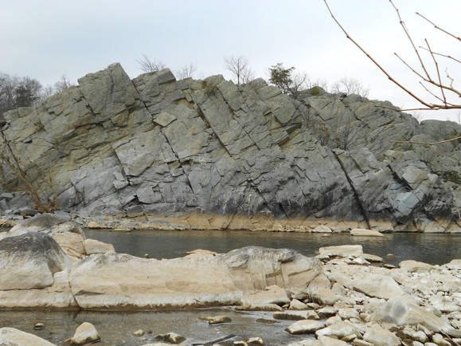
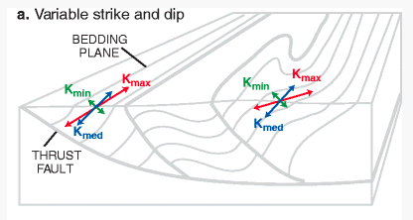
Representation of Anisotropy
Representation of full 3D anisotropy may be required for some problems (fractured aquifers, structurally deformed aquifers)
Some capabilities available (LVDA, SUTRA), but needed generalized CVFD method

Slide 15
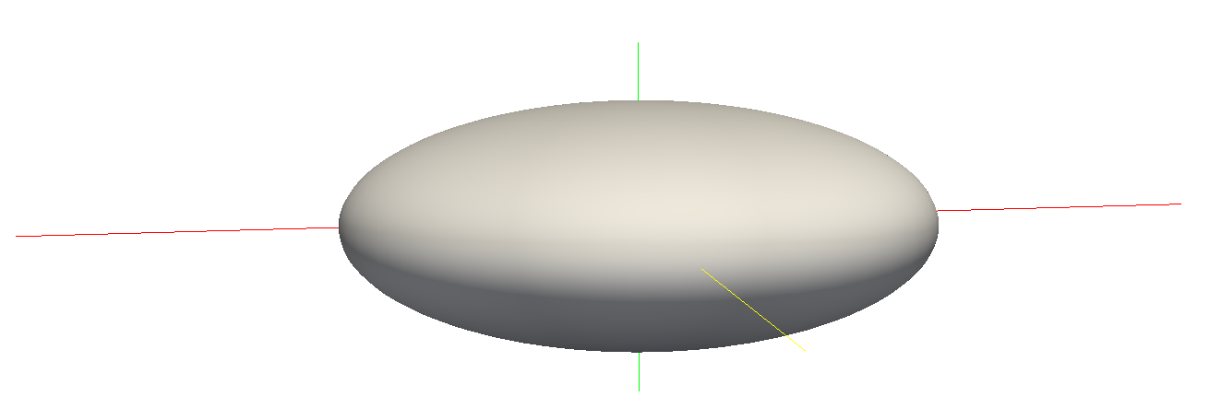
Hydraulic Conductivity Ellipsoid
Defined by three user-provided values on a cell by cell basis
For unrotated case,
K11 = Kx
K22 = Ky
K33 = Kz
K11
K22
K33

Slide 16
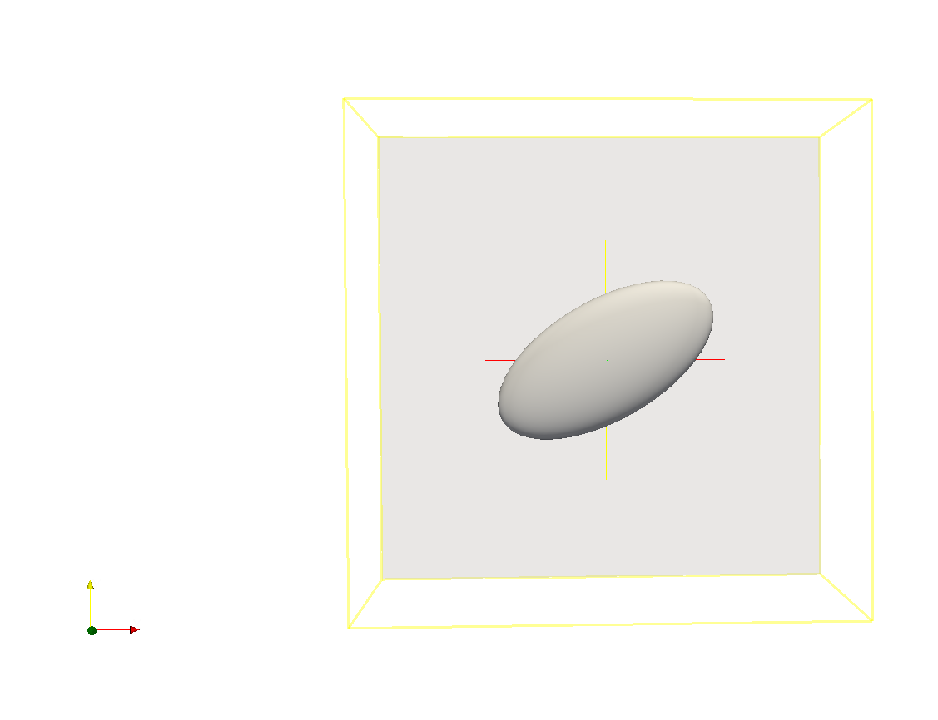
Ellipsoid Rotation
Users can optionally provide ANGLE1, ANGLE2, and ANGLE3 on a cell by cell basis
ANGLE1 is counter-clockwise rotation in the x, y plane

Slide 17
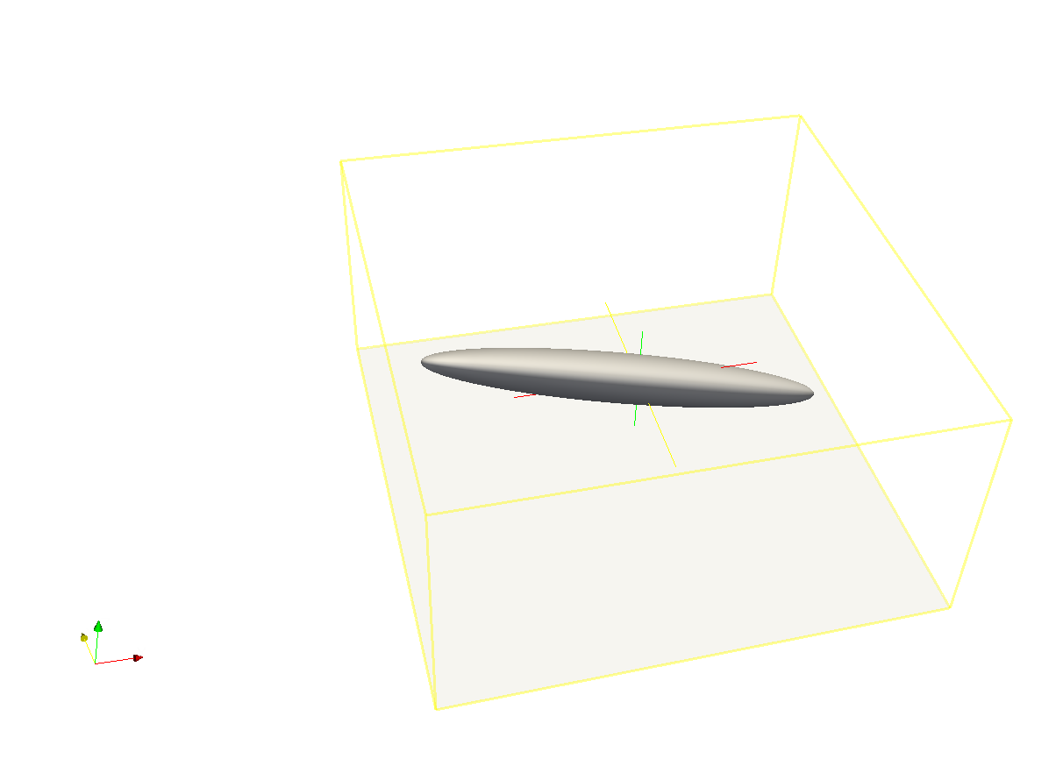
Ellipsoid Rotation (cont.)
All three angles can be specified to represent ellipsoid orientation

Slide 18
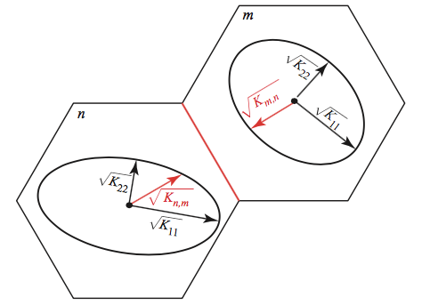
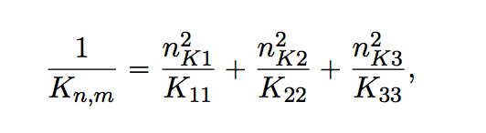
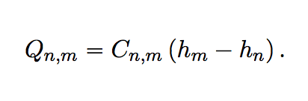
Effective Conductivity Approach
Large errors for certain ellipsoid configurations
Approximate, but relatively fast
Simple to implement

Slide 19
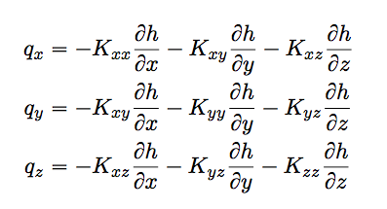
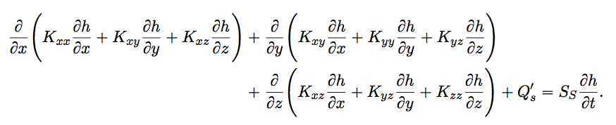
XT3D Approach
General and robust handling of anisotropy
Computationally expensive
Improves flow solution for certain grid types
More on this later

Slide 20
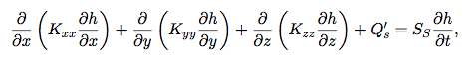
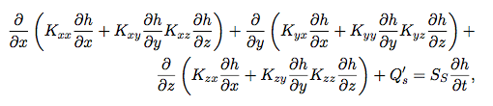
Groundwater Flow Equation
Traditional MODFLOW
Generalized 3D Anisotropic Flow

Slide 21
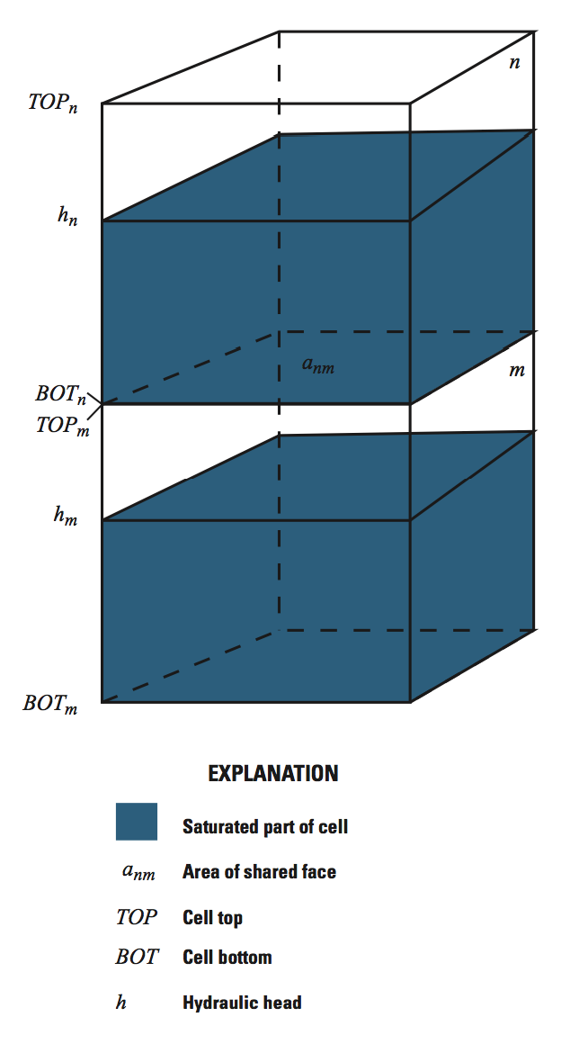
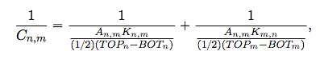
Vertical Conductance Options
Default (stable)
Others
VARIABLECV
DEWATERED
PERCHED
Vertical conductance calculation: DEFAULT (most stable)

Slide 22
storage

Slide 23
Storage (STO) Package
Steady state if STO Package not specified for a simulation
Cells are treated as confined or convertible (ICONVERT)
Aquifer storage properties (SS and SY) are specified
Individual stress periods are marked as steady state or transient

Slide 24
Traditional stress packages

Slide 25
Traditional Packages
Specified head (CHD) Package
No more IBOUND. Must use CHD
Can turn CHD cells on and off by stress period
Well (WEL) Package
Recharge (RCH) Package
Array-based or list based
River (RIV) Package
General-Head Boundary (GHB) Package
Drain (DRN) Package
Evapotranspiration (EVT) Package
Array-based or list based

Slide 26
Advanced packages

Slide 27
Advanced Packages
Multi-Aquifer Well (MAW) Package
Stream-Flow Routing (SFR) Package
Lake (LAK) Package
Unsaturated Zone Flow (UZF) Package
Water Mover (MVR) Package
More on these later…

Slide 28
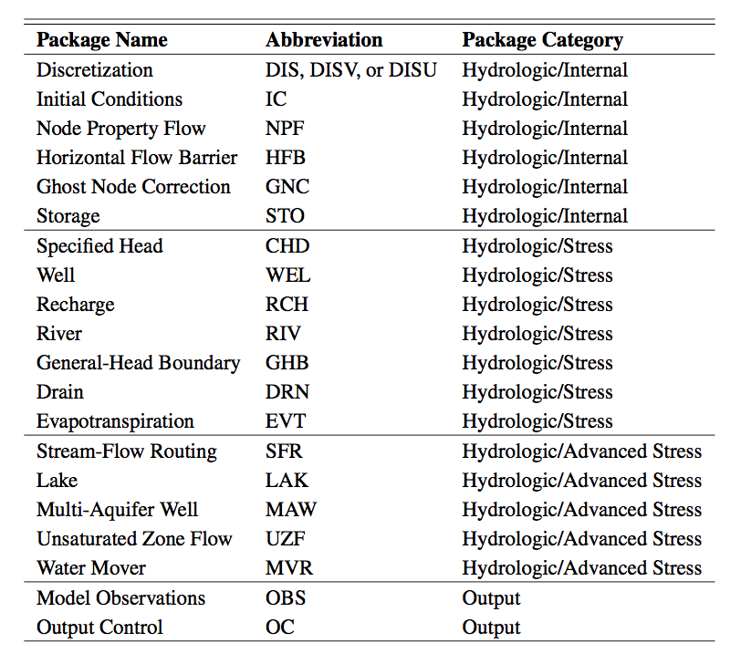
All GWF Packages

Slide 29
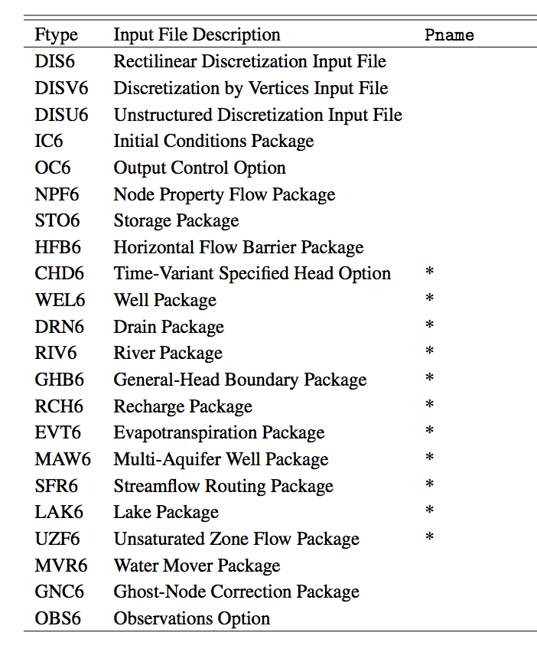
Multiple Package of Same Type

Slide 30
SIMULATION CONCEPT

Slide 31
Simulation Components
Simulation
Timing Module
Solutions
Models
Exchanges
Utilities
Timing Module
Solution 1
Model 1
Model 2
Model 3
Model 4
Exchange 1
Exchange 2
Exchange 3

Slide 32
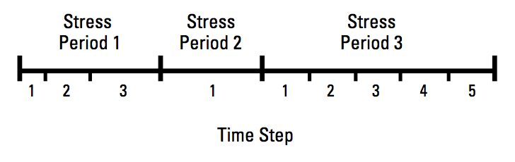
Timing Module
TDIS Package
Uses the MODFLOW concepts of stress periods, time steps
Alternative timing packages may be developed in the future
Timing applies to all models

Slide 33
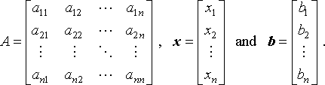
Solutions
Used to solve one or more models and exchanges
The only solution available now is the Iterative Model Solution, or IMS
Unstructured and asymmetric
IMS solves the following nonlinear equation
Ax = b

Slide 34
INPUT and output

Slide 35
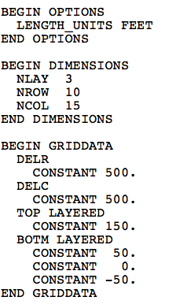
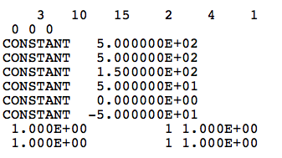
Blocks and Keywords
MODFLOW 6 DIS
MODFLOW-2005 DIS

Slide 36
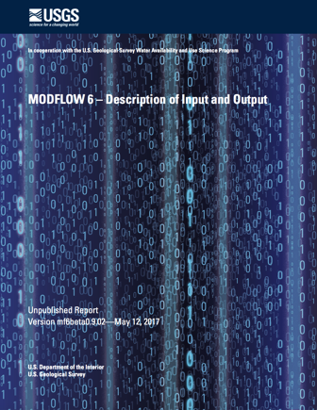
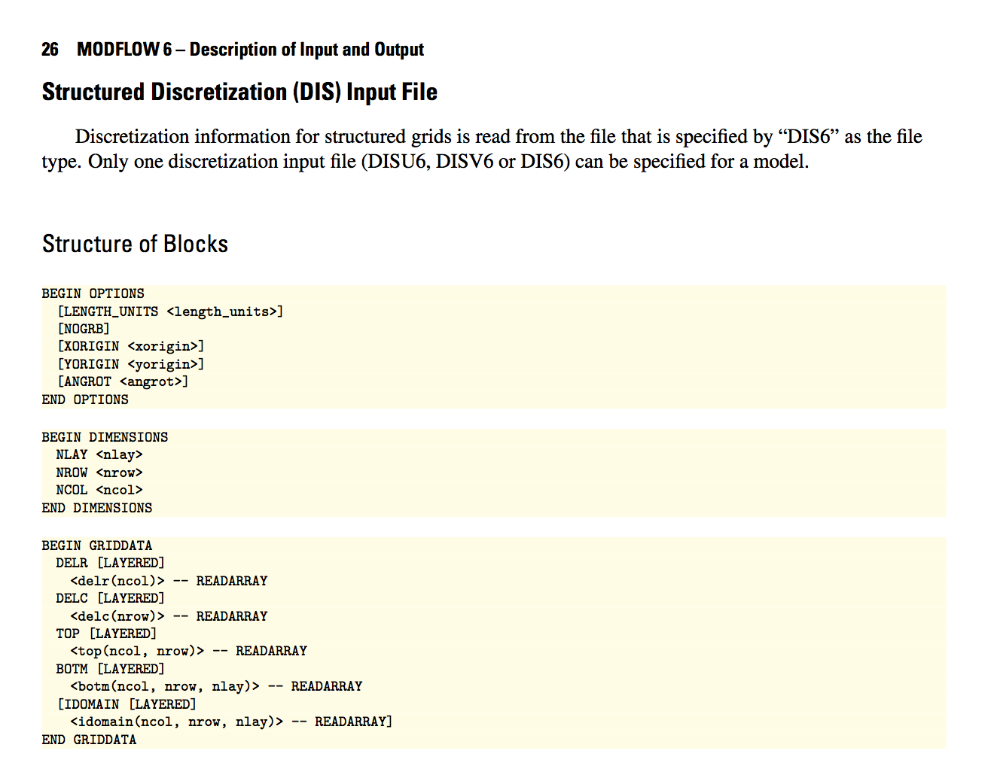
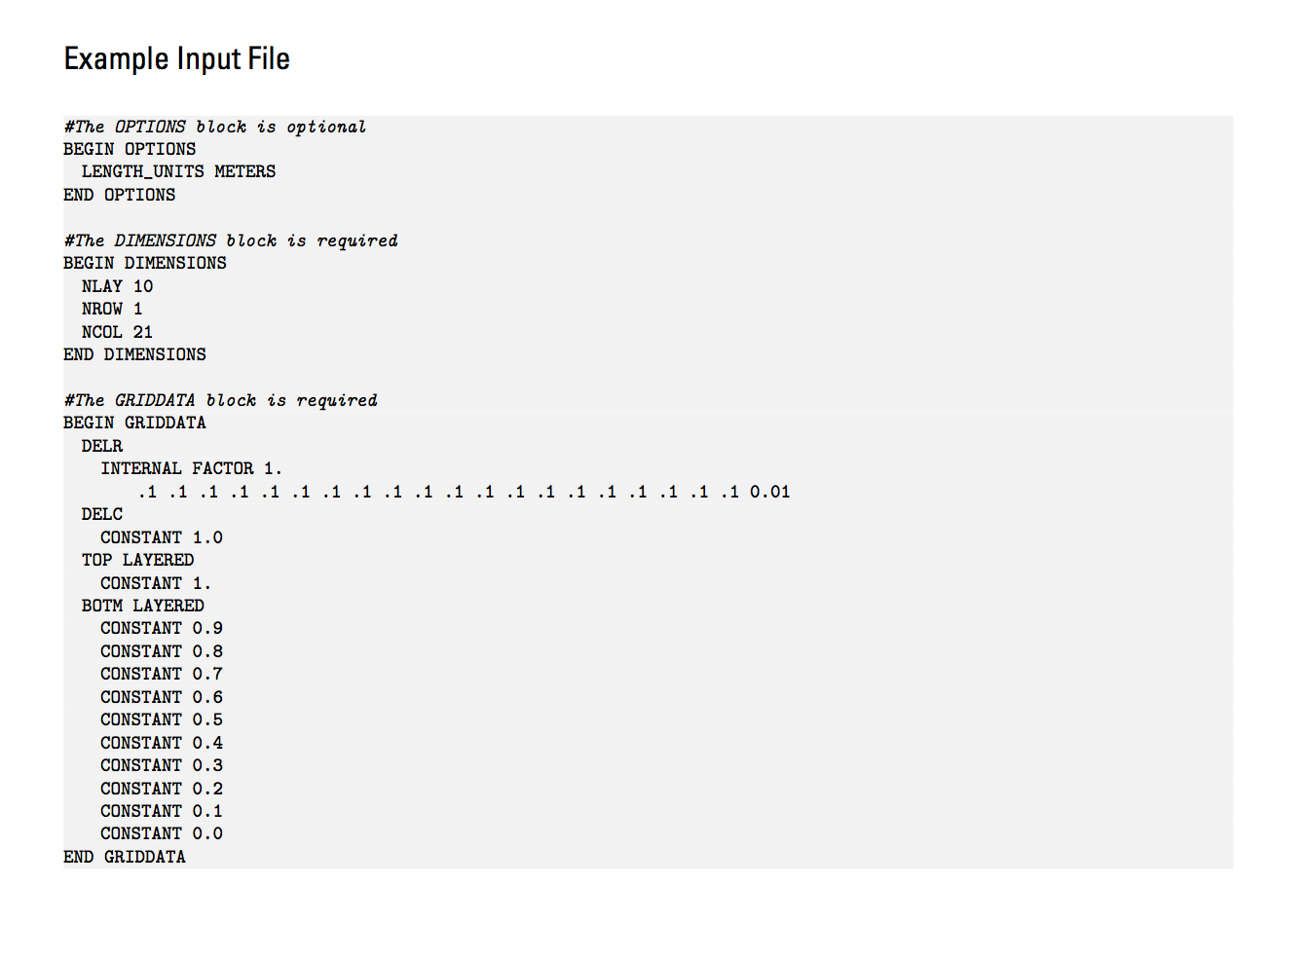
Blocks and Keywords
Notes:
Human readable
Better error trapping
Easily allows new options to be added, without breaking backward compatibility
Most blocks support OPEN/CLOSE

Slide 37
Input Files
Keywords are not case sensitive
Some input is optional and marked in user guide with brackets []
Lines can be commented with “#”
Time series variables are marked in blue
Words can be separated by spaces, tabs, and commas (in some cases)
Output files are no longer specified in the name file

Slide 38
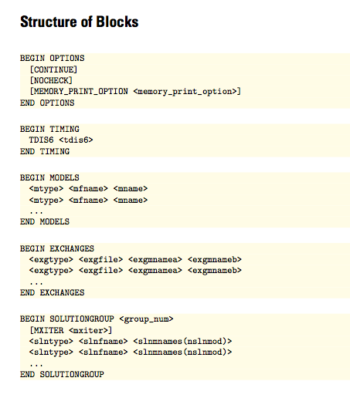
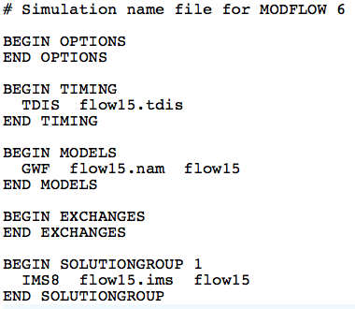
Simulation Name File
Required even for common case with one model
Named mfsim.nam
One simulation per folder

Slide 39
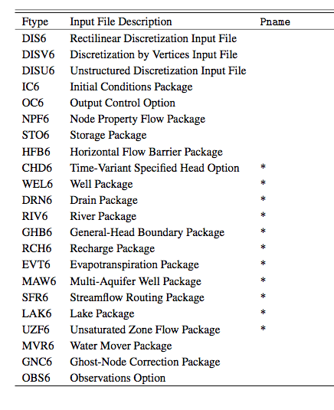
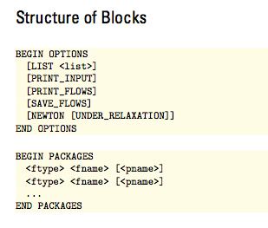
GWF Name File

Slide 40
Example GWF Name File
BEGIN OPTIONS
END OPTIONS
BEGIN PACKAGES
DIS6 ps1.dis
IC6 ps1.ic
NPF6 ps1.npf
CHD6 ps1.chd
END PACKAGES

Slide 41
Stress Period Data
BEGIN OPTIONS
PRINT_INPUT
PRINT_FLOWS
SAVE_FLOWS
END OPTIONS
BEGIN DIMENSIONS
MAXBOUND 42
END DIMENSIONS
BEGIN PERIOD 1
# canal
1 1 1 330.0
1 2 1 330.0
1 3 1 330.0
1 4 1 330.0
...
# river
1 1 20 320.0
1 2 20 320.0
1 3 20 320.0
...
END PERIOD
Stress are active until changed by the user
Different from previous MODFLOW versions
Can be specified using time series

Slide 42
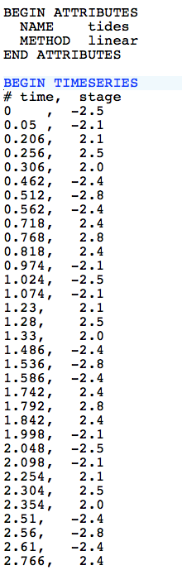
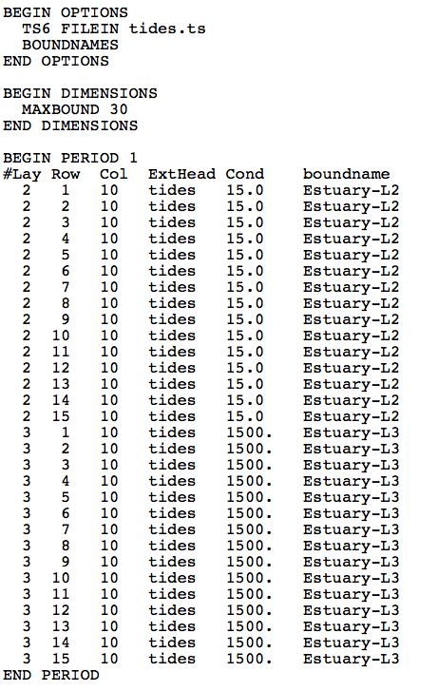
Time Series
tides.ts
GHB Input File

Slide 43
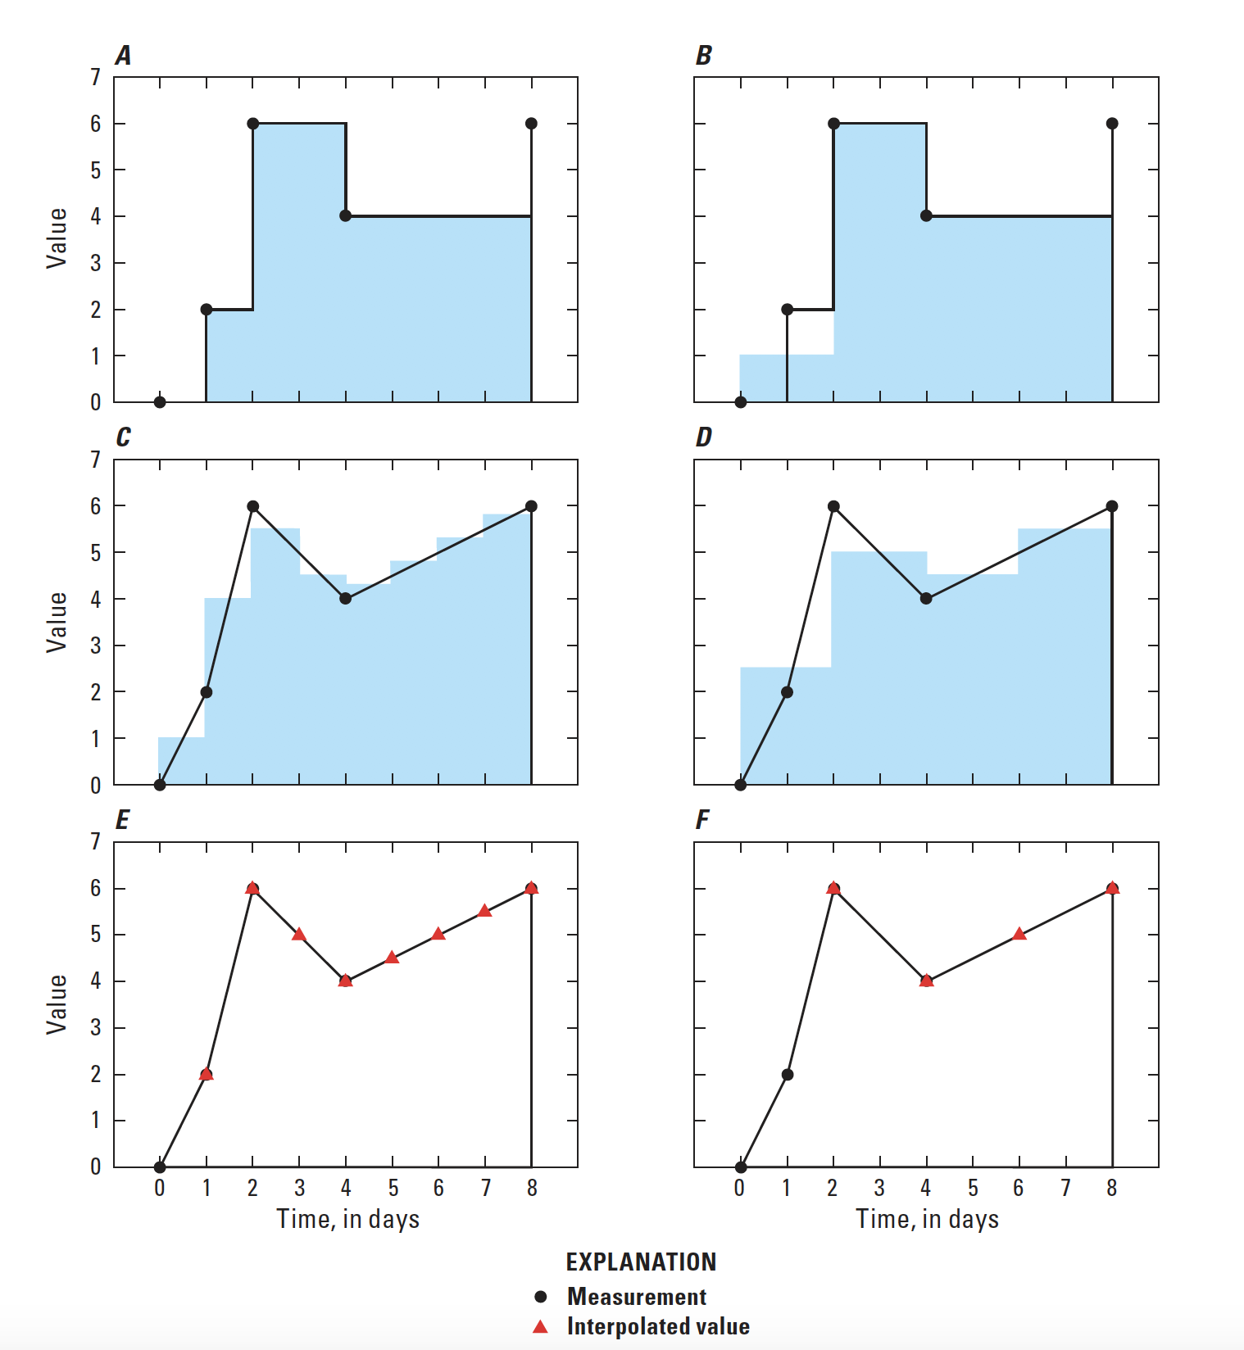
Timeseries Interpolation Methods
STEPWISE
Values are constant until changed
LINEAR
Average value is calculated for the time step
LINEAREND
Value interpolated at end of time step

Slide 44
Types of Output
Listing files
Simulation list file (mfsim.lst)
Model list file (e.g. ps1.lst)
Heads
Automatically printed to GWF list file at end of stress period
Can also be written to a binary file
Budgets
Can be written to GWF list file (not recommended)
Can also be written to a binary file
Observations
Written to CSV (comma separated value) files
Binary Grid File
Always written; useful for post processors
All binary files are double precision

Slide 45
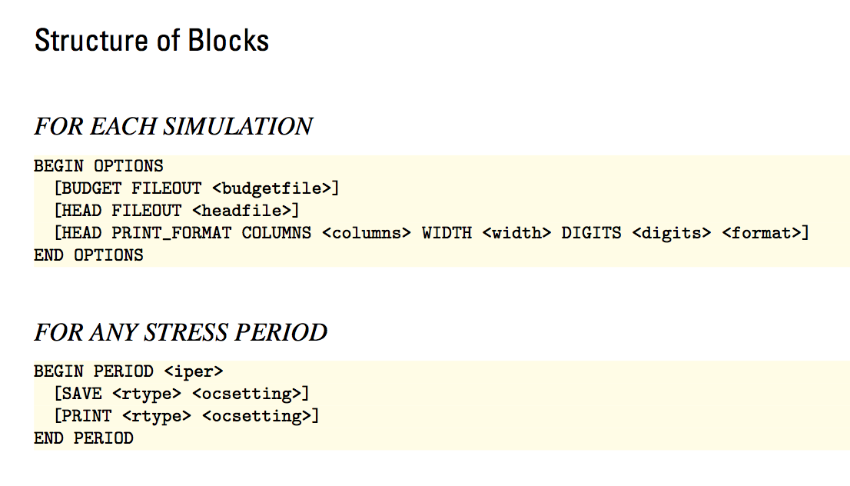
Output Control File
Names of budget and head files to create

Slide 46
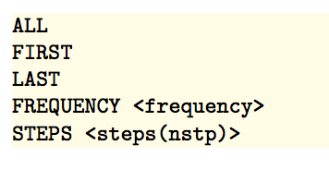
Output Control File
How often to save or print for the stress period
e.g. SAVE HEAD LAST

Slide 47
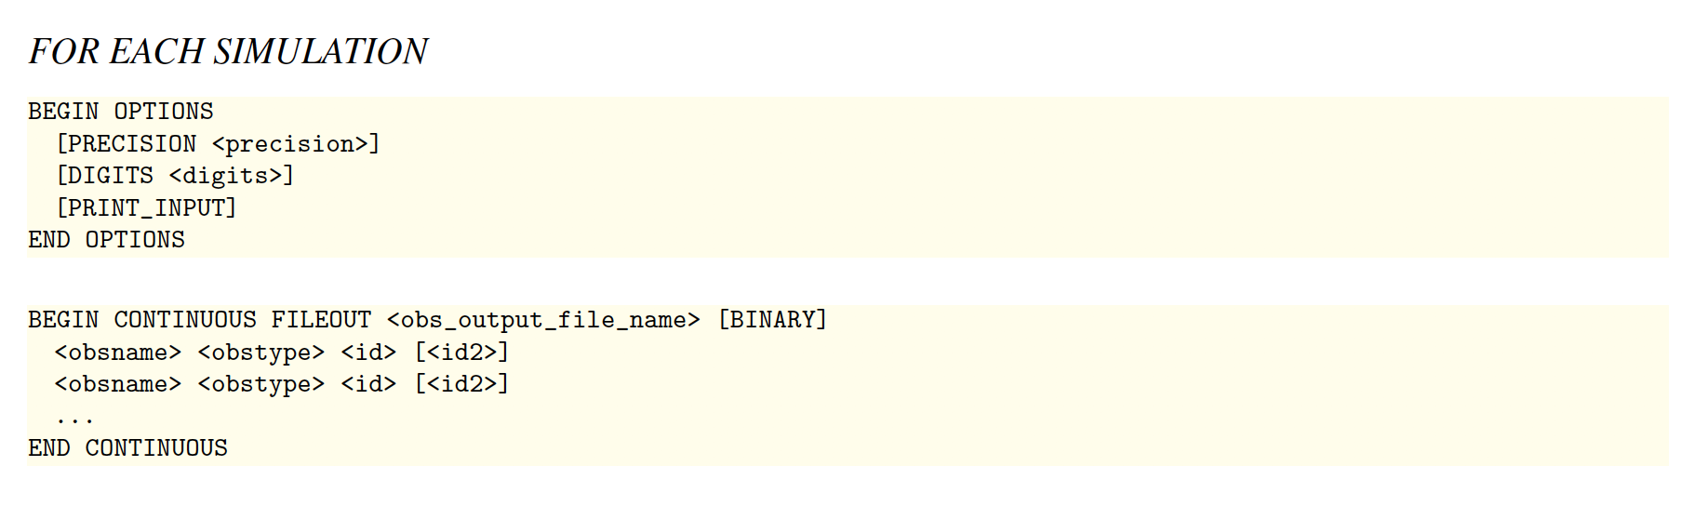
Observations
OBS Package for GWF Model
Heads
Flow between cells
Separate OBS files for each package

Slide 48
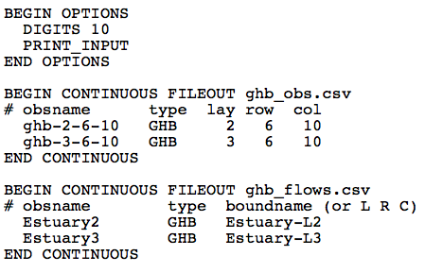
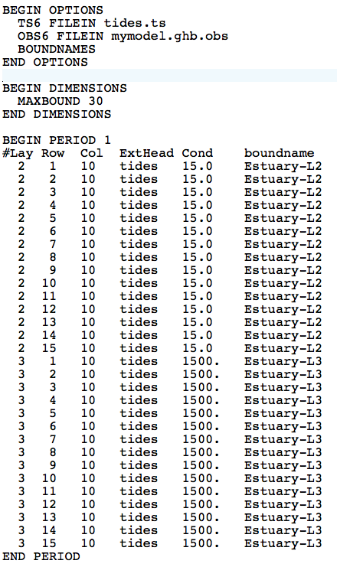
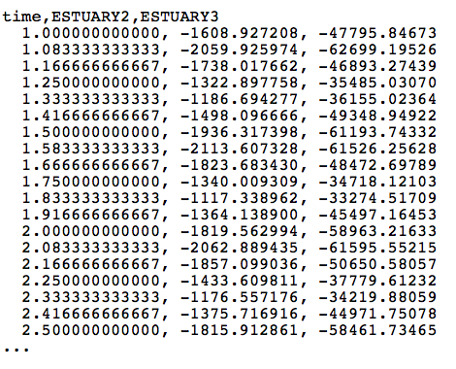
Boundname
mymodel.ghb.obs

Slide 49
Example problem

Slide 50
Steady-state flow with constant head boundaries
Map View
Cross Section View
Canal
330
320
Aquifer 1
Kh = 50 ft/d
Kv = 10 ft/d
220
silt
200
Kh = Kv = 0.01 ft/d
10,500 feet
Kh = 200 ft/d
Aquifer 2
Kv = 20 ft/d
0
River
W
E
W
10,000 feet
E

Slide 51
MODFLOW Grid and Boundary Conditions
Map View
Cross Section View
330
320
Layer 1 (Aquifer 1)
220
Layer 2 (silt)
200
Layer 3 (Aquifer 2)
0
W
E
3 layers, 21 rows, 20 columns Horizontal grid cell size = 500 feet x 500 feet Canal simulated with constant head cells in in layer 1, column 1, rows 1 - 21 River simulated with constant head cells in layer 1, column 20, rows 1 – 21
No flow boundaries along the North, South, and Bottom

Slide 52
MODFLOW Data Files ps1-steady
mfsim.nam – MODFLOW Simulation name file
ps1.tdis – Time Discretization package file
ps1.ims – Iterative Model Solution package file
ps1.nam – Groundwater Flow Model name file
ps1.dis – Spatial Discretization package file
ps1.ic – Initial Conditions package file
ps1.chd – Constant Head package file
ps1.npf – Node Property Flow package file
ps1.oc – Output Control file

Slide 53
MODFLOW Data Files ps1-trans
mfsim.nam – MODFLOW Simulation name file
ps1.tdis – Time Discretization package file
ps1.ims – Iterative Model Solution package file
ps1.nam – Groundwater Flow Model name file
ps1.dis – Spatial Discretization package file
ps1.ic – Initial Conditions package file
ps1.chd – Constant Head package file
ps1.npf – Node Property Flow package file
ps1.oc – Output Control file
ps1.sto – Storage package file
ps1.chd.ts – time series file
ps1.obs – Observations package file

Slide 54
Additional information

Slide 55
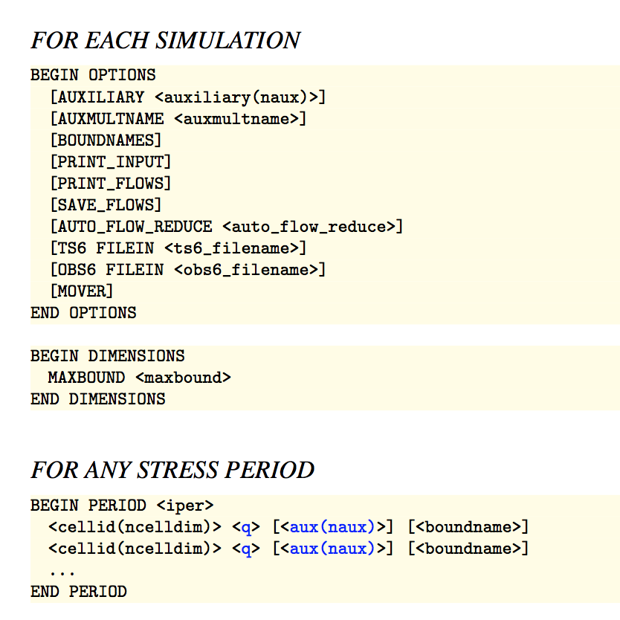
Well (WEL) Package

Slide 56
Well (WEL) Package
MAXBOUND is the maximum number of boundary cells that will be active in any stress period.
BEGIN OPTIONS
END OPTIONS
BEGIN DIMENSIONS
MAXBOUND 1
END DIMENSIONS
BEGIN PERIODDATA
3 11 10 -1.5E5
END PERIODDATA

Slide 57
Well (WEL) Package
List of boundary cells. These cells will remain as boundary cells until another PERIOD block is encountered.
BEGIN OPTIONS
END OPTIONS
BEGIN DIMENSIONS
MAXBOUND 1
END DIMENSIONS
BEGIN PERIODDATA
3 11 10 -1.5E5
END PERIODDATA

Slide 58
Well (WEL) Package
Auxiliary variables
BEGIN OPTIONS
AUXILIARY IFACE
END OPTIONS
BEGIN DIMENSIONS
MAXBOUND 1
END DIMENSIONS
BEGIN PERIODDATA
3 11 10 -1.5E5 0
END PERIODDATA

Slide 59
Well (WEL) Package
Boundnames
BEGIN OPTIONS
BOUNDNAMES
END OPTIONS
BEGIN DIMENSIONS
MAXBOUND 1
END DIMENSIONS
BEGIN PERIODDATA
3 11 10 -1.5E5 MYWELL
END PERIODDATA

Slide 60
Well (WEL) Package
PRINT_INPUT: echo input to the listing file
PRINT_FLOWS: write calculated CHD flows to the listing file
SAVE_FLOWS: write calculated flows to budget file
BEGIN OPTIONS
PRINT_INPUT
PRINT FLOWS
SAVE_FLOWS
END OPTIONS
BEGIN DIMENSIONS
MAXBOUND 1
END DIMENSIONS
BEGIN PERIODDATA
3 11 10 -1.5E5
END PERIODDATA

Slide 61
Well (WEL) Package
Variables shown in blue can be represented using time series. Values are interpolated each time step from a user-provided time series record.

Slide 62
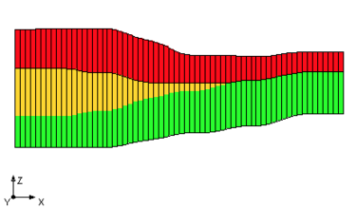
IDOMAIN Capability
How does IDOMAIN affect flows written by MODFLOW?
Cell connections are more flexible, so needed to rethink “FLOW RIGHT FACE”, ...
Cell connectivity is written to the “binary grid file”
Flows between adjacent cells, “FLOW JA FACE”, corresponds to cell connectivity in binary grid file

